Slide 1


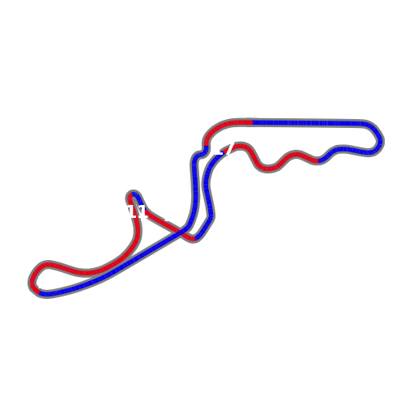
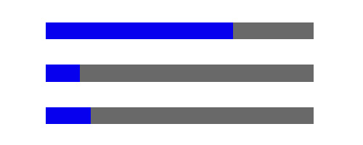

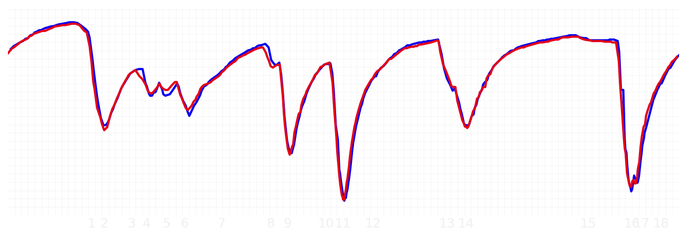
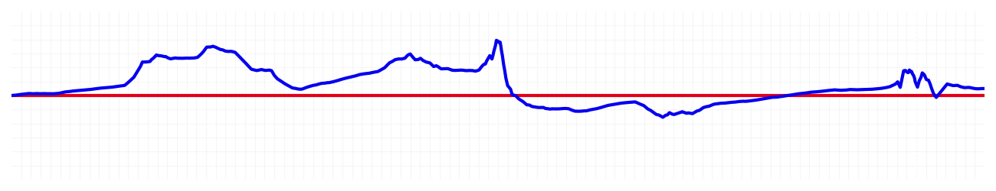
Japanese GP Qualifying Q1
Max Verstappen
Driver
Yuki Tsunoda
Driver
Lap Time
01:27.943
01:27.967
Lap Time
Sector 1
30.696
Speed Trap 1
288 kp/h
Speed Trap 1
285 kp/h
Sector 1
30.839
Sector 2
39.718
Speed Trap 2
299 kp/h
Gap
-0.024
Gap
0.024
Speed Trap 2
296 kp/h
Sector 2
39.679
Sector 3
17.529
Speed Final Line
270 kp/h
Corner Advantage
9/19
Corner Advantage
10/19
Speed Final Line
270 kp/h
Sector 3
17.449
FULL THROTTLE
70%
68%
FULL THROTTLE
HEAVY BREAKING
13%
11%
HEAVY BREAKING
%LAP TIME
CORNERING
17%
21%
CORNERING
%LAP TIME
SPEED
SPEED
DELTA TIME
DELTA TIME

Slide 2

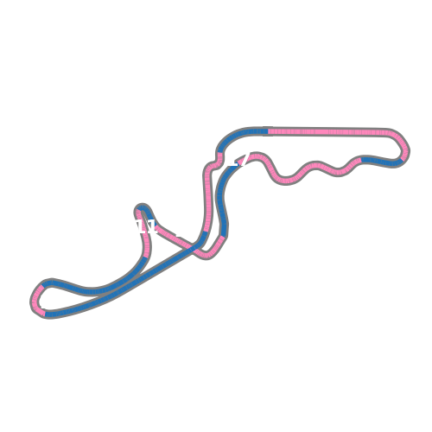
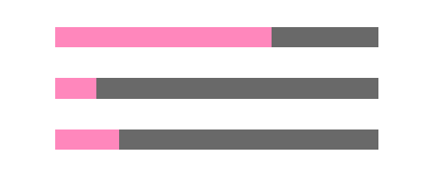

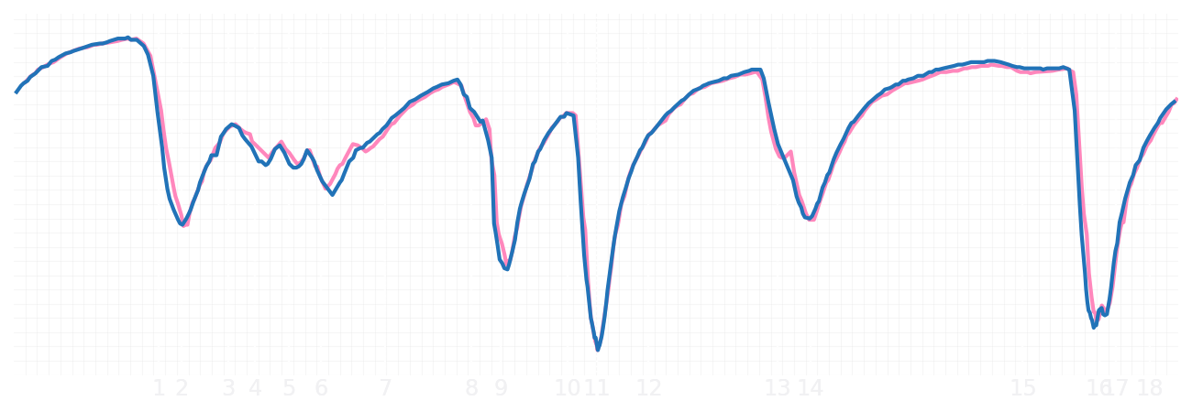
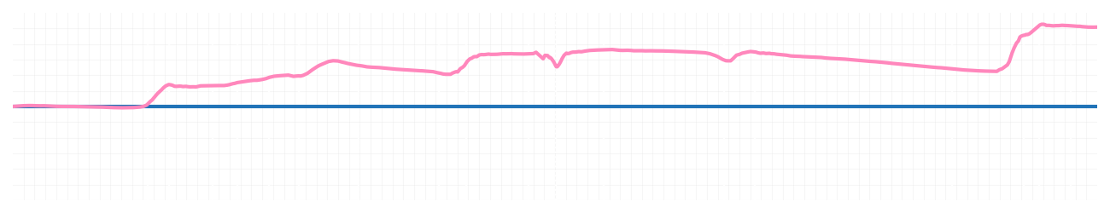
Japanese GP Qualifying Q1
Pierre Gasly
Driver
Jack Doohan
Driver
Lap Time
01:28.186
01:28.877
Lap Time
Sector 1
30.666
Speed Trap 1
286 kp/h
Speed Trap 1
288 kp/h
Sector 1
30.983
Sector 2
40.091
Speed Trap 2
297 kp/h
Gap
-0.691
Gap
0.691
Speed Trap 2
301 kp/h
Sector 2
40.186
Sector 3
17.429
Speed Final Line
270 kp/h
Corner Advantage
7/19
Corner Advantage
12/19
Speed Final Line
270 kp/h
Sector 3
17.708
FULL THROTTLE
67%
67%
FULL THROTTLE
HEAVY BREAKING
13%
13%
HEAVY BREAKING
%LAP TIME
CORNERING
20%
20%
CORNERING
%LAP TIME
SPEED
SPEED
DELTA TIME
DELTA TIME

Slide 3

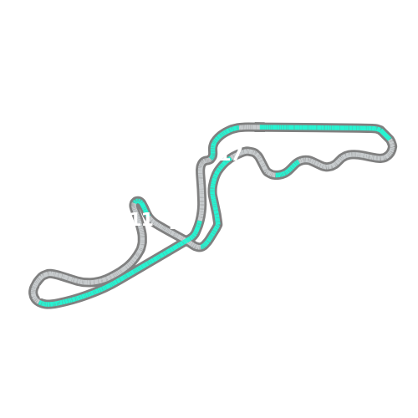
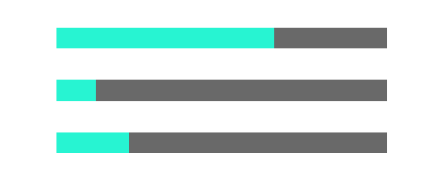
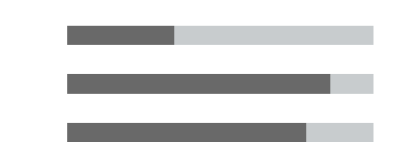
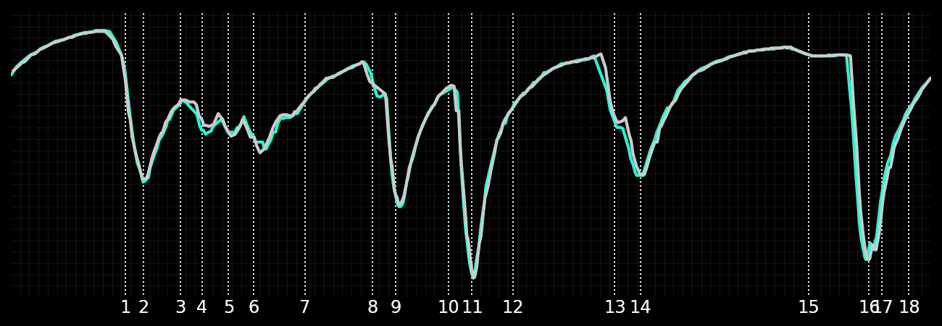
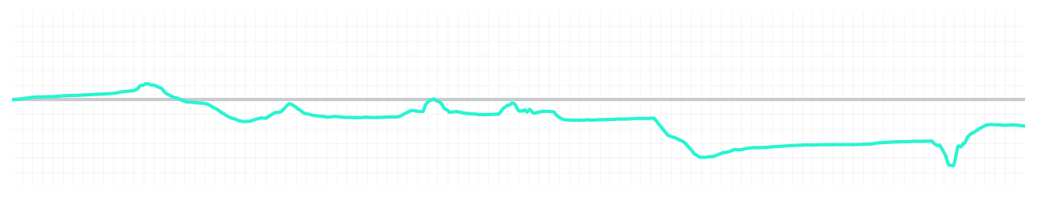
Japanese GP Qualifying Q1
Kimi Antonelli
Driver
George Russell
Driver
Lap Time
01:27.968
01:27.843
Lap Time
Sector 1
30.900
Speed Trap 1
287 kp/h
Speed Trap 1
288 kp/h
Sector 1
30.738
Sector 2
39.685
Speed Trap 2
304 kp/h
Gap
0.125
Gap
-0.125
Speed Trap 2
304 kp/h
Sector 2
39.662
Sector 3
17.383
Speed Final Line
270 kp/h
Corner Advantage
11/19
Corner Advantage
8/19
Speed Final Line
273 kp/h
Sector 3
17.443
FULL THROTTLE
66%
65%
FULL THROTTLE
HEAVY BREAKING
12%
14%
HEAVY BREAKING
%LAP TIME
CORNERING
22%
21%
CORNERING
%LAP TIME
SPEED
SPEED
DELTA TIME
DELTA TIME

Slide 4

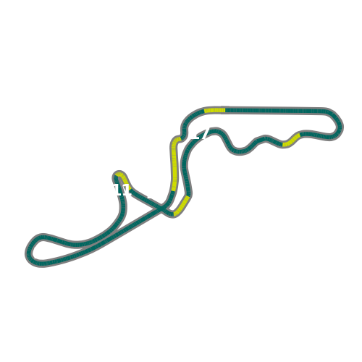

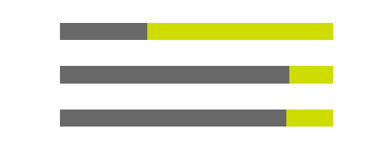
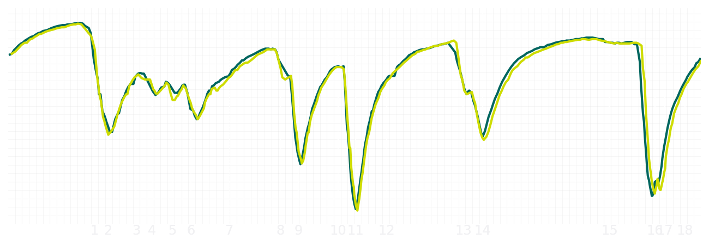
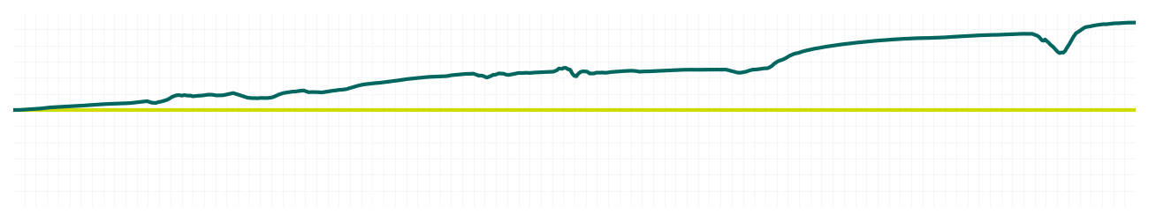
Japanese GP Qualifying Q1
Fernando Alonso
Driver
Lance Stroll
Driver
Lap Time
01:28.337
01:29.271
Lap Time
Sector 1
30.725
Speed Trap 1
287 kp/h
Speed Trap 1
285 kp/h
Sector 1
31.034
Sector 2
39.982
Speed Trap 2
299 kp/h
Gap
-0.934
Gap
0.934
Speed Trap 2
297 kp/h
Sector 2
40.483
Sector 3
17.630
Speed Final Line
269 kp/h
Corner Advantage
4/19
Corner Advantage
15/19
Speed Final Line
268 kp/h
Sector 3
17.754
FULL THROTTLE
69%
68%
FULL THROTTLE
HEAVY BREAKING
14%
16%
HEAVY BREAKING
%LAP TIME
CORNERING
17%
16%
CORNERING
%LAP TIME
SPEED
SPEED
DELTA TIME
DELTA TIME

Slide 5

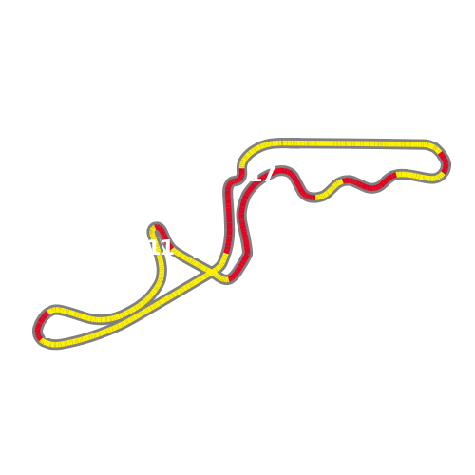
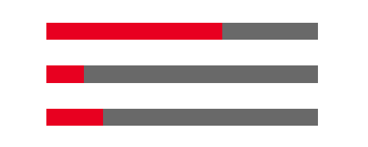

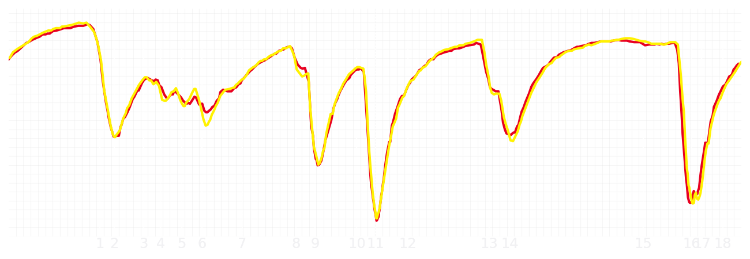
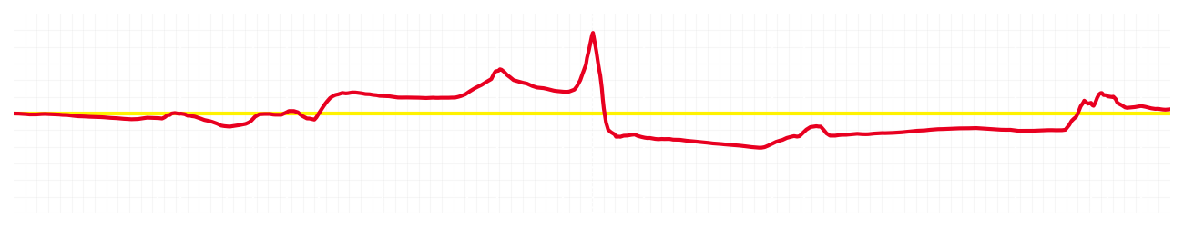
Japanese GP Qualifying Q1
Charles Leclerc
Driver
Lewis Hamilton
Driver
Lap Time
01:27.920
01:27.942
Lap Time
Sector 1
30.670
Speed Trap 1
289 kp/h
Speed Trap 1
289 kp/h
Sector 1
30.673
Sector 2
39.841
Speed Trap 2
300 kp/h
Gap
-0.022
Gap
0.022
Speed Trap 2
300 kp/h
Sector 2
39.776
Sector 3
17.409
Speed Final Line
271 kp/h
Corner Advantage
9/19
Corner Advantage
10/19
Speed Final Line
272 kp/h
Sector 3
17.493
FULL THROTTLE
65%
67%
FULL THROTTLE
HEAVY BREAKING
14%
17%
HEAVY BREAKING
%LAP TIME
CORNERING
21%
16%
CORNERING
%LAP TIME
SPEED
SPEED
DELTA TIME
DELTA TIME

Slide 6

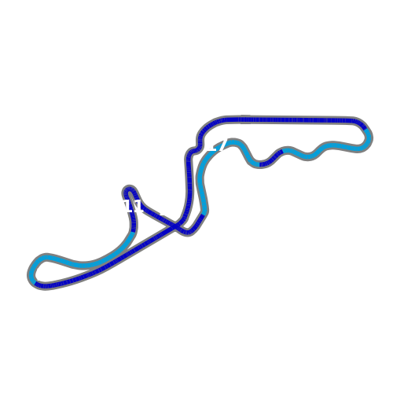
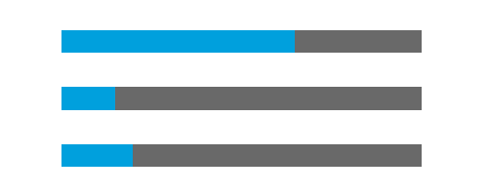
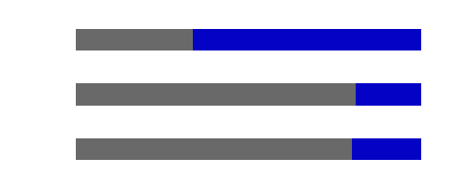
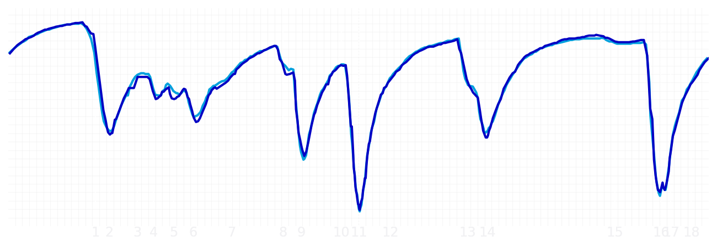
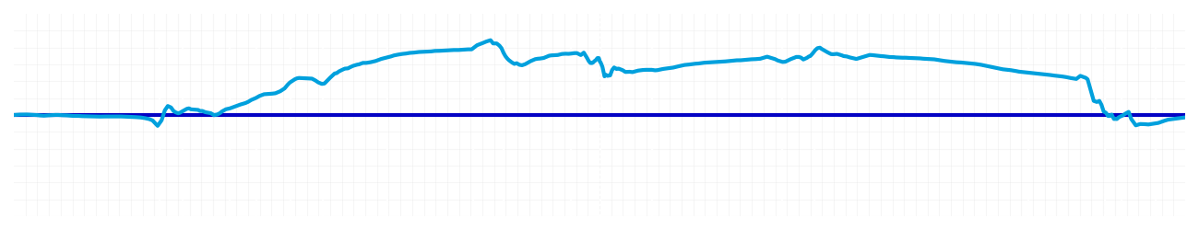
Japanese GP Qualifying Q1
Alexander Albon
Driver
Carlos Sainz
Driver
Lap Time
01:28.218
01:28.209
Lap Time
Sector 1
30.763
Speed Trap 1
288 kp/h
Speed Trap 1
288 kp/h
Sector 1
30.935
Sector 2
39.851
Speed Trap 2
300 kp/h
Gap
0.009
Gap
-0.009
Speed Trap 2
302 kp/h
Sector 2
39.794
Sector 3
17.604
Speed Final Line
272 kp/h
Corner Advantage
10/19
Corner Advantage
9/19
Speed Final Line
271 kp/h
Sector 3
17.480
FULL THROTTLE
65%
66%
FULL THROTTLE
HEAVY BREAKING
15%
19%
HEAVY BREAKING
%LAP TIME
CORNERING
20%
15%
CORNERING
%LAP TIME
SPEED
SPEED
DELTA TIME
DELTA TIME

Slide 7

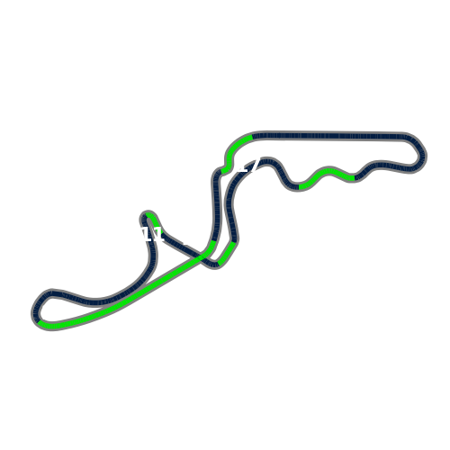
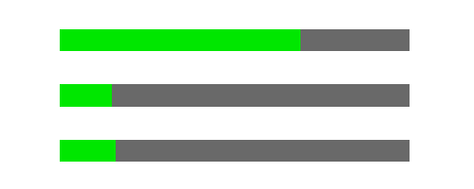

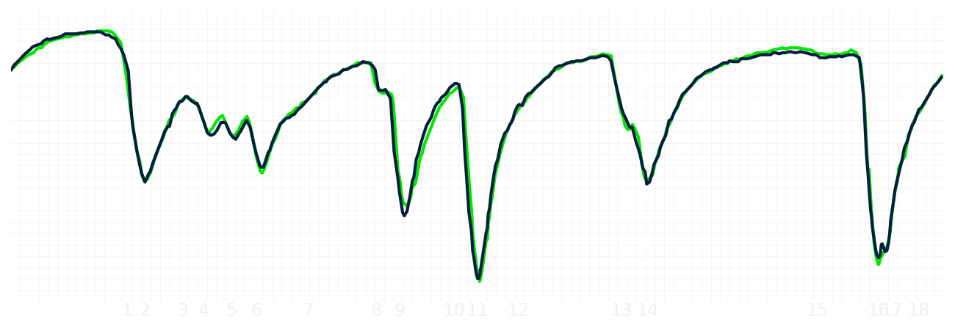
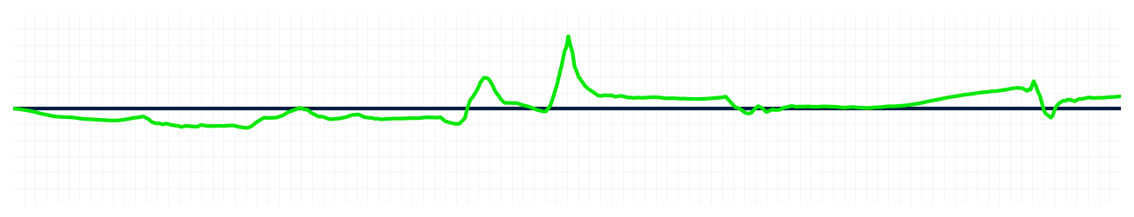
Japanese GP Qualifying Q1
Nico Hulkenberg
Driver
Gabriel Bortoleto
Driver
Lap Time
01:28.570
01:28.622
Lap Time
Sector 1
31.082
Speed Trap 1
288 kp/h
Speed Trap 1
287 kp/h
Sector 1
31.080
Sector 2
39.984
Speed Trap 2
300 kp/h
Gap
-0.052
Gap
0.052
Speed Trap 2
297 kp/h
Sector 2
Sector 3
17.504
Speed Final Line
272 kp/h
Corner Advantage
11/19
Corner Advantage
8/19
Speed Final Line
271 kp/h
Sector 3
17.542
FULL THROTTLE
69%
67%
FULL THROTTLE
HEAVY BREAKING
15%
13%
HEAVY BREAKING
%LAP TIME
CORNERING
16%
20%
CORNERING
%LAP TIME
SPEED
SPEED
DELTA TIME
DELTA TIME

Slide 8

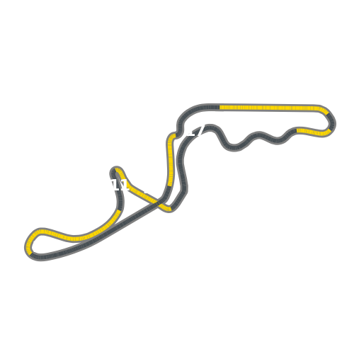
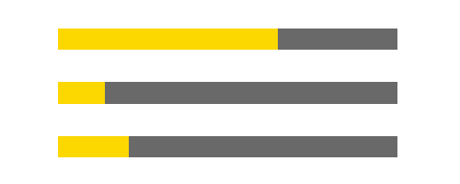
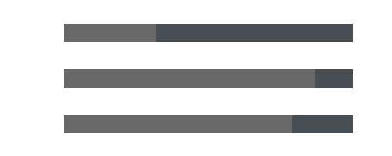
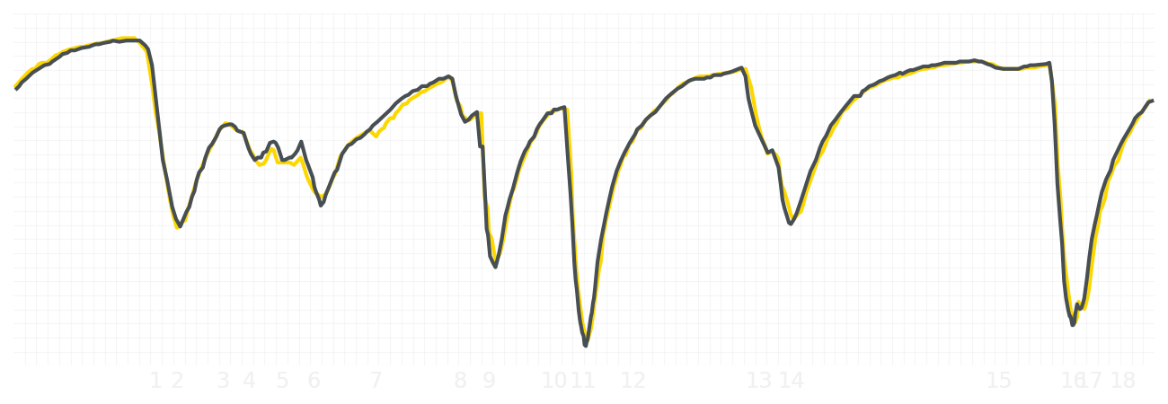
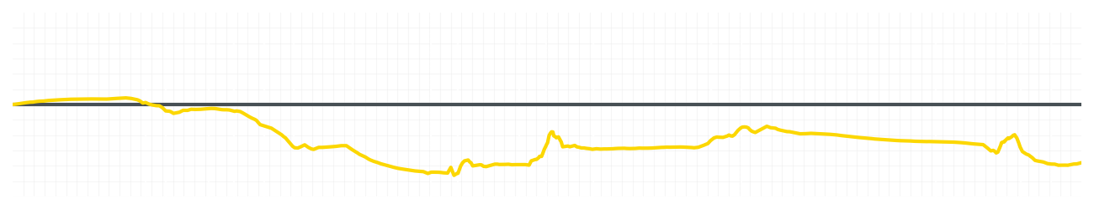
Japanese GP Qualifying Q1
Liam Lawson
Driver
Isack Hadjar
Driver
Lap Time
01:28.554
01:28.278
Lap Time
Sector 1
31.194
Speed Trap 1
285 kp/h
Speed Trap 1
287 kp/h
Sector 1
30.924
Sector 2
39.833
Speed Trap 2
299 kp/h
Gap
0.276
Gap
-0.276
Speed Trap 2
300 kp/h
Sector 2
39.881
Sector 3
17.527
Speed Final Line
270 kp/h
Corner Advantage
11/19
Corner Advantage
8/19
Speed Final Line
268 kp/h
Sector 3
17.473
FULL THROTTLE
65%
68%
FULL THROTTLE
HEAVY BREAKING
14%
13%
HEAVY BREAKING
%LAP TIME
CORNERING
21%
19%
CORNERING
%LAP TIME
SPEED
SPEED
DELTA TIME
DELTA TIME

Slide 9

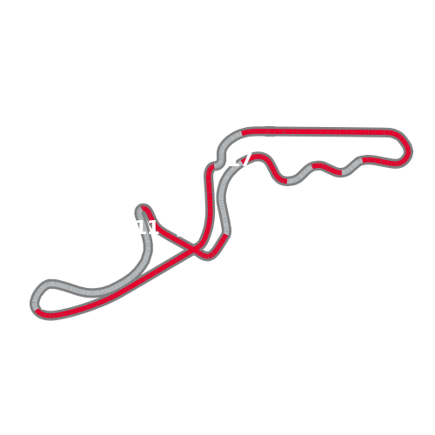


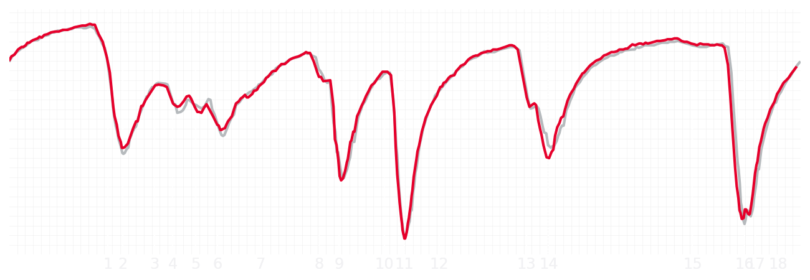
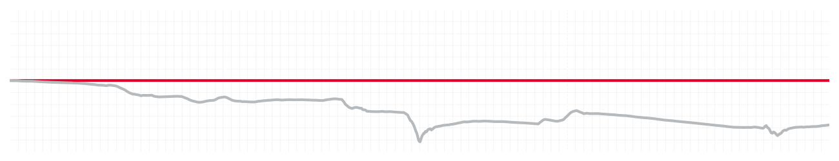
Japanese GP Qualifying Q1
Esteban Ocon
Driver
Ollie Bearman
Driver
Lap Time
01:28.696
01:28.228
Lap Time
Sector 1
31.041
Speed Trap 1
286 kp/h
Speed Trap 1
286 kp/h
Sector 1
30.831
Sector 2
40.137
Speed Trap 2
296 kp/h
Gap
0.468
Gap
-0.468
Speed Trap 2
299 kp/h
Sector 2
39.938
Sector 3
17.518
Speed Final Line
271 kp/h
Corner Advantage
10/19
Corner Advantage
9/19
Speed Final Line
268 kp/h
Sector 3
17.459
FULL THROTTLE
66%
68%
FULL THROTTLE
HEAVY BREAKING
19%
17%
HEAVY BREAKING
%LAP TIME
CORNERING
15%
15%
CORNERING
%LAP TIME
SPEED
SPEED
DELTA TIME
DELTA TIME

Slide 10

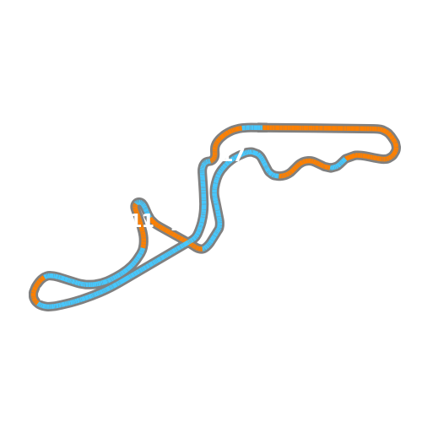

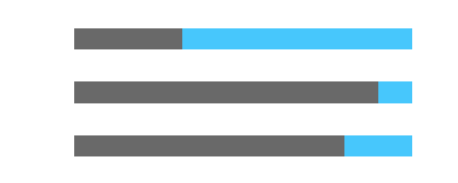
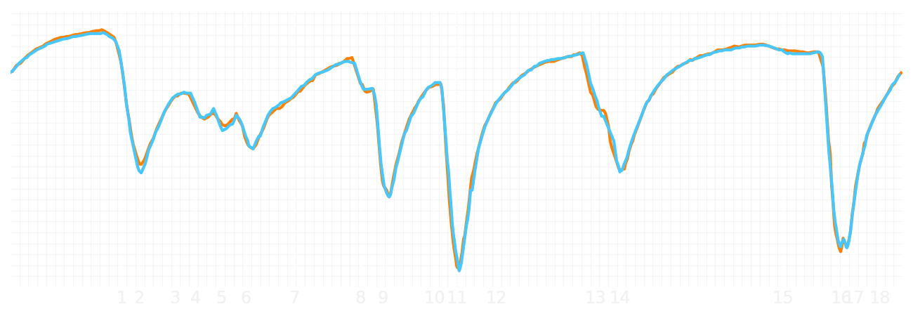
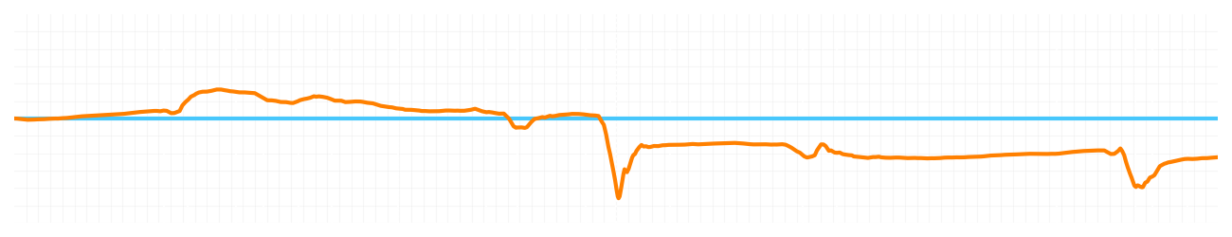
Japanese GP Qualifying Q1
Lando Norris
Driver
Oscar Piastri
Driver
Lap Time
01:27.845
01:27.687
Lap Time
Sector 1
30.610
Speed Trap 1
288 kp/h
Speed Trap 1
287 kp/h
Sector 1
30.690
Sector 2
39.725
Speed Trap 2
303 kp/h
Gap
0.158
Gap
-0.158
Speed Trap 2
301 kp/h
Sector 2
39.542
Sector 3
17.510
Speed Final Line
272 kp/h
Corner Advantage
8/19
Corner Advantage
11/19
Speed Final Line
271 kp/h
Sector 3
17.455
FULL THROTTLE
68%
68%
FULL THROTTLE
HEAVY BREAKING
12%
10%
HEAVY BREAKING
%LAP TIME
CORNERING
20%
22%
CORNERING
%LAP TIME
SPEED
SPEED
DELTA TIME
DELTA TIME

